Slide 1

RTU –MAJOR PROJECT
8TH SEM I.T. (Information Technology)
04-05-2019
HARSHUL SHARMA
PALLAV SHUKLA
ARUNDHATI
Project Mentor : Mr. Narendra Singh Patel (Asst. Professor)

Slide 2
PHAB –ROADMAP
1- Line Introduction
Assembled Data
Causes of Book Wastage
Front layout
App Overview
Workflow
FutureScope
Conclusion

Slide 3
PHAB – 1 LINE INTRODUCTION
An app to reuse the old books .

Slide 4
PHAB – ASSEMBLED DATA
Worldwide consumption of paper has risen by 400% in the past 40 years, with 35% of harvested trees being used for paper manufacture. Although it’s tough to arrive at an accurate estimate, as the weight of different kinds of wood, the size of trees, and the type of pulping process
The United States produced about 20,700,000 tons of this paper last year, which by reckoning takes 55 to 110 million trees, but we only recycle about 11,000,000 tons, or 53 percent, according to the American Forest and Paper Association. Deforestation is often seen as a problem in developing countries but also occurs in the developed world.
93% of paper comes from trees. 50% of the waste of businesses is composed of paper.To print a Sunday edition of the New York Times requires 75,000 trees are needed! Recycling 1 ton of paper ,26,500 liters of water and 17 trees.

Slide 5
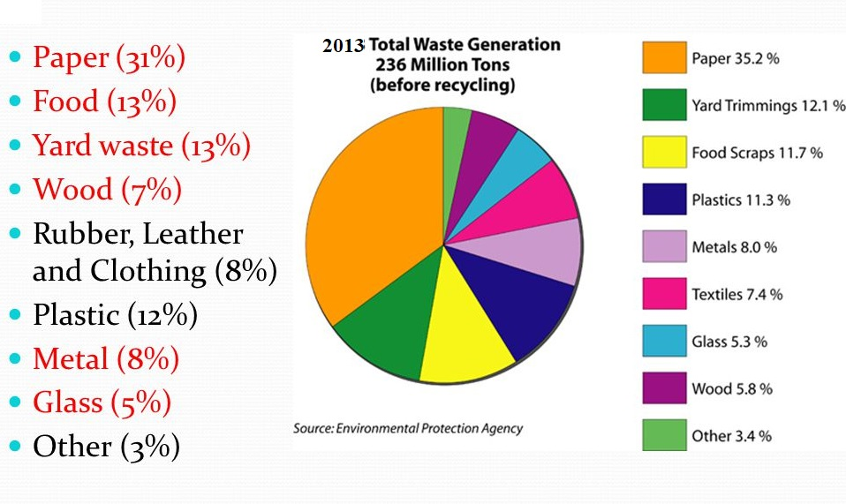
PHAB– ASSEMBLED DATA

Slide 6
PHAB – ASSEMBLED DATA
According to the report released by Environmental Protection Agency in 2013 :
1)Before recycling the total waste generation i.e 236 millions tons consists of approximately 35.2% of the paper waste.
2)According to the report approximately 30.8% of the paper is successfully recycled.
3) Lots of resources are used up in recycling 31% of paper.

Slide 7
PHAB– ASSEMBLED DATA
4) The another problem that catches our attention from student’s point of view is that not every student is able to get the books required at the exam time and whoever gets the books, gets it at a high price.
5)once the exams are over the students who bought the books are no longer of use for them . So in all we can say that it is a wastage of money.

Slide 8
PHAB – ASSEMBLED DATA
6) During the critical exam time , the student needs to surf for e-books , due to which there is a wastage of time.
7) As per regress use of class notes of one particular person , many a times student face problem in finding the notes to be used again in semester.

Slide 9
PHAB –ASSEMBLED DATA
8) Thinking from that student’s point of view, that student has to send the notes again and again to their classmates.
9) The same problem is faced by the faculty that he/she needs to share the same notes for every batch.
10) In engineering, students also use the Xeroxed books and notes, once the semester passes they are of no use, they don’t have a resale value and the shopkeepers don’t even accept these Xeroxed material so these materials are then wasted.

Slide 10
CAUSES OF BOOK WASTAGE
According to the analysis there are many different factors for book wastage:
1) Due to the less senior junior interaction the user can not sell his/her book.
2) Xeroxed books neither have a resale value nor can be accepted by the shopkeepers.
3) Students often do not get right buyer at the right time.
4) Many a times due to the monopoly of the shopkeepers the students compromise to sell their books at a very low price.

Slide 11
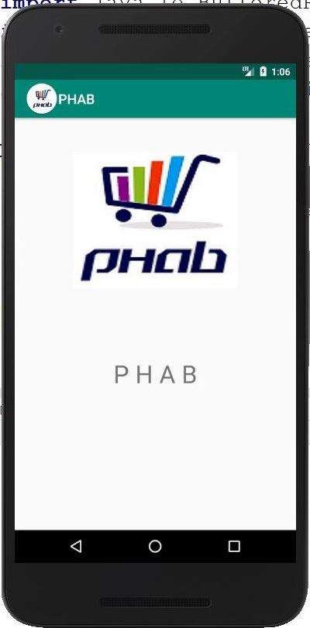
PHAB – FRONT LAYOUT
END OF PHASE 1 PPT

Slide 12

PHAB – App Overview
The sole aim : continues with our app as follows:
-1) Considering enormous amount of book wastage in the present scenario. Our app aims at reusing the books, novels through the technology of android web application.

Slide 13
PHAB – App Overview
2) It becomes unaffordable for each and every student to buy new books and it also becomes difficult to arrange the old books may be because of less senior junior interaction or due to the unavailability of books in the library in that much amount, in every semester, so here phab comes as a savoir for the students.

Slide 14
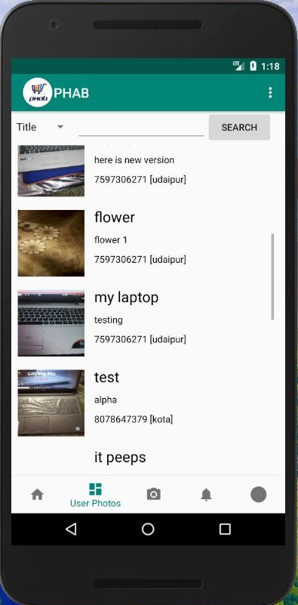
PHAB – App Overview
-3) PHAB a common platform: in which the user can view all the novel , books and pdf’s , uploaded by some trusted user, and contact them for buying it.

Slide 15
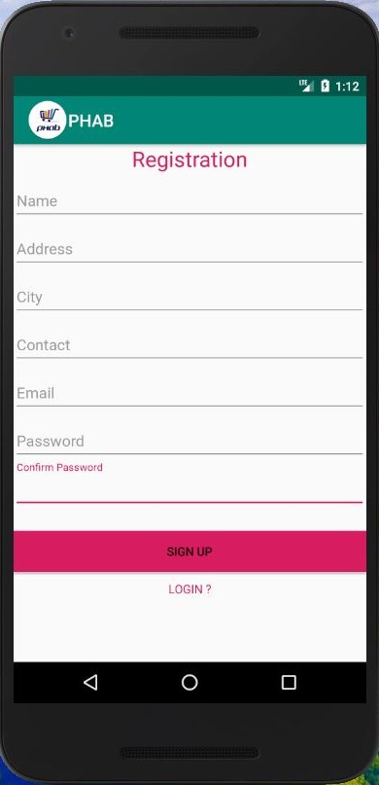
PHAB – WORKFLOW
1) Registration: To use our app a user needs to sign up in it. Now there appears a form in which the user has to fill all the basic information about them like name, address, email id, passwordetc

Slide 16
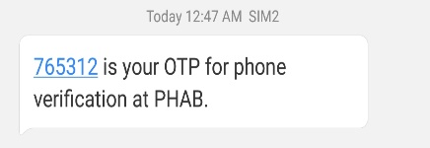
PHAB – WORKFLOW
2) Authentication: Once the user registers with phab app, the user has to login using the email id and the password. And then the user will be sent the OTP verification code to the registered mobile number.

Slide 17
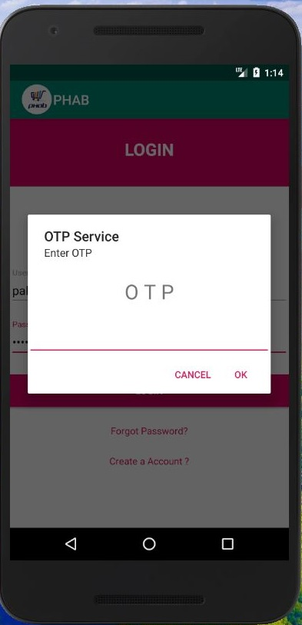
PHAB – WORKFLOW
3) Login: Once the user has registered with the Phab , the user needs to login in it. Now there appears a form in which the user has to fill all the basic information about them like name, address, email id, password etc. Now you have successfully registered yourself in Phab.

Slide 18
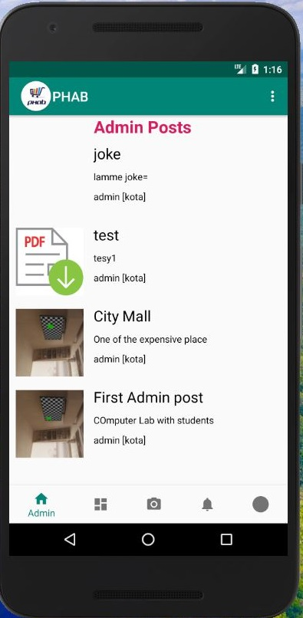
PHAB – WORKFLOW
4) Admin Posts: In this page of PHAB app the admin can upload any of his books and pdfs that he wants to sell and he can also suggests some of his trustworthy users and some updates

Slide 19
PHAB – WORKFLOW
5) User Posts: After Surfing on the admin post, user can slide to all the users post available for buying. He can scroll various books novels and notes available in the phab, the user can click on the post available he can view the further details of the post. He has a choice to search any post by name of the seller, or by title and description or by title of the users post.

Slide 20
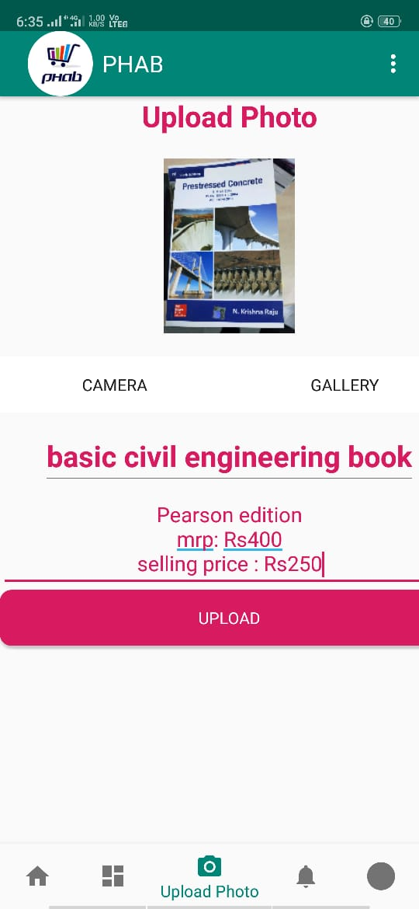
PHAB – WORKFLOW
6) Upload Photos: The user have to upload the front cover page of the book he is selling and also he can specify the selling price of the book that he wants to sell in the description section below.

Slide 21
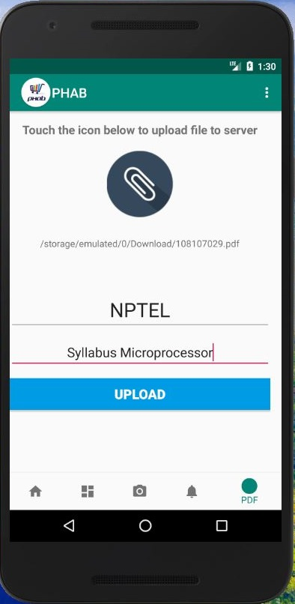
PHAB – WORKFLOW
7) Upload PDFs: First the user should select the pdf from the device by clicking on the pdf icon and then add a title and description of the pdf the finally clicking on upload button.
Now the viewer can see the post in the users post section, by clicking on the users post button present in the bottom navigation bar.

Slide 22
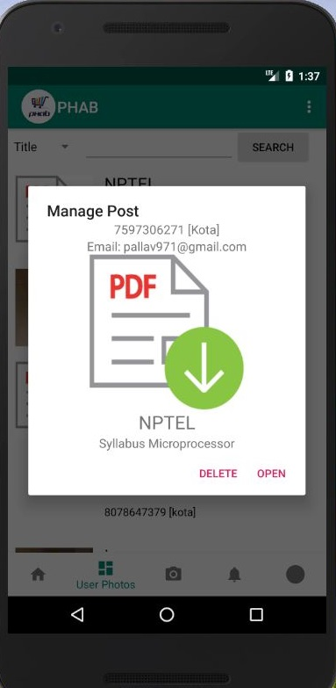
PHAB – WORKFLOW
- 8) Admin can delete any pdf that the admin finds inappropriate. the admin can keep an eye on the activity of every user that is posting.

Slide 23
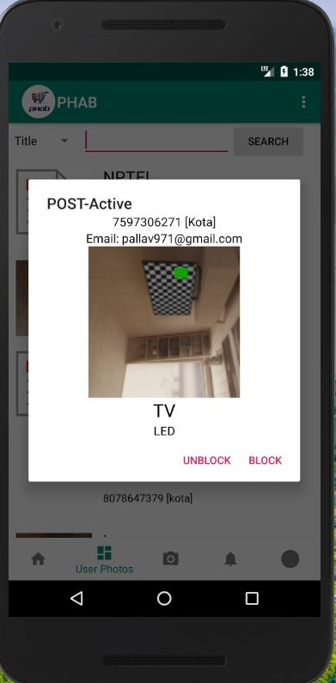
PHAB – WORKFLOW
9) Admin can block and unblock any user or any post that is not suitable from the app’s point of view.

Slide 24
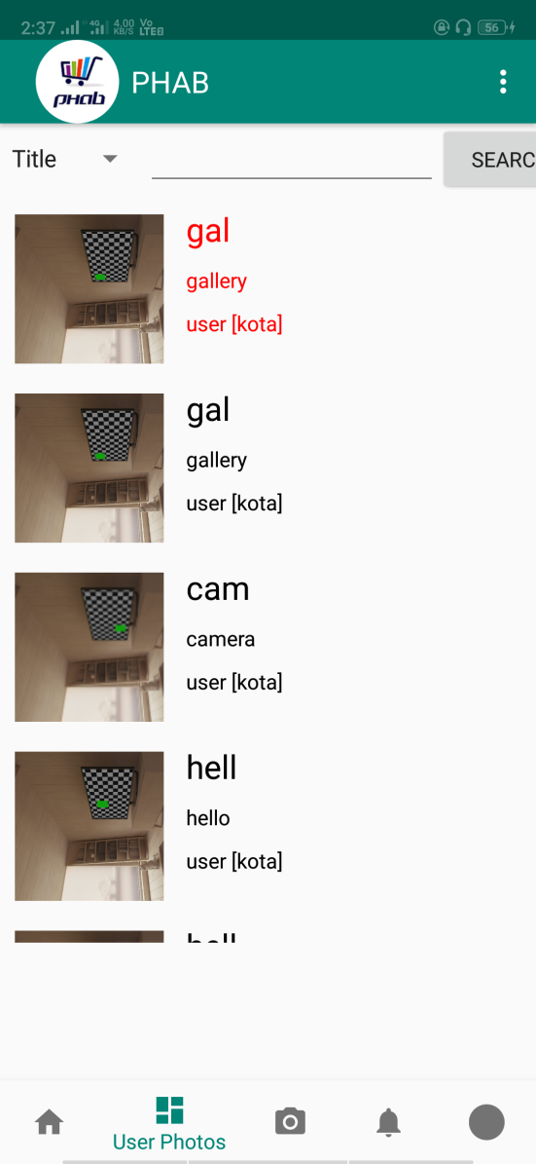
PHAB – WORKFLOW
10) The post blocked by admin can easily be differentiated from other post as it is shown in different color only to admin and the one who has uploaded it.

Slide 25
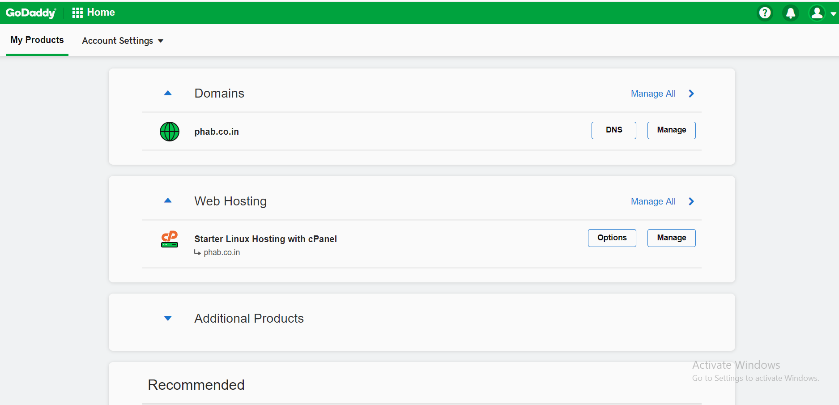
ALPHA – WORKFLOW

Slide 26
PHAB – FUTURE SCOPE
There are many ways we can expand this app:
1) In future we will hire delivery boys, after which there will not be any need of direct contact between seller and buyer as the delivery boy will pick the parcel from seller and deliver it to buyer’s address with a minimal delivery charge.
2) We will be integrating Payment method in our app.
3) We are also thinking of uploading library books data after taking permissions from colleges, as students has doubt that particular book is available in library or not, so by simple searching on PHAB he/she can get to know about the book that is available.

Slide 27
PHAB – FUTURE SCOPE
4) We will be sorting the students according to their colleges, so that it would be convenient to search in there surrounding and first in their particular colleges, then after nearby colleges or area.
5) We will also be adding the option of renting the books for a few days according to the lender’s choice and will be taking back after checking the condition of the book.

Slide 28





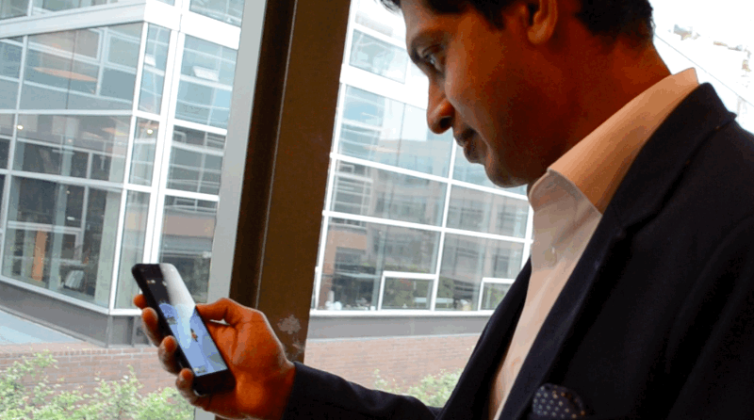
PHAB – CONCLUSION
Message Sent
Message Sent
Message Sent

Slide 29

RTU –MINOR PROJECT
8TH SEM I.T. (Information Technology)
04-05-2019
HARSHUL SHARMA
PALLAV SHUKLA
ARUNDHATI PALIWAL
Project Mentor : Narendra Singh Patel (Astt. Prof.)

